Slide 1

Interview Presentation

Slide 2




Write a bash script to calculate the
Frequency of each word in a text file words.txt
EG:
CODE:
awk '{for(word=1;word<=NF;word++){print $word}}' word.txt | sort | uniq -c | sort -nr

Slide 3
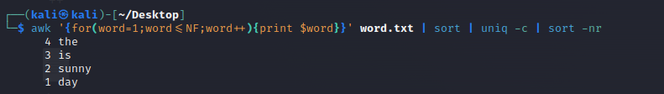
Output:

Slide 4
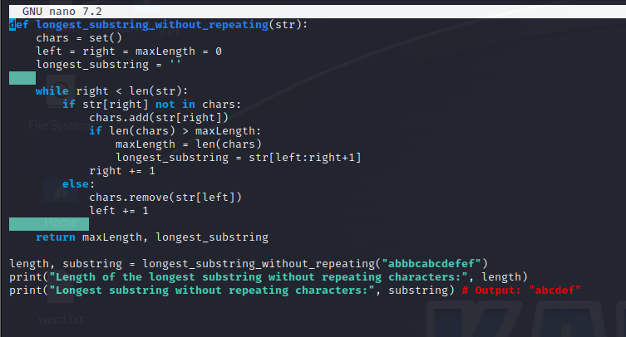
2. Find the length of the longest substring without repeating characters.let str = "abbbcabcdefef"
Code:

Slide 5

OUTPUT:

